Slide 1
Competence Project Dadiu 2018
Sigurbjörn Jónsson
Team 4

Slide 2
Before I started…
I hadn‘t done any motion matching in the minigames
Neither of our teams minigames had trajectory matching
The team had a good function of turning .bvh files into readable json
My goal:
Move a character with trajectory matching

Slide 3
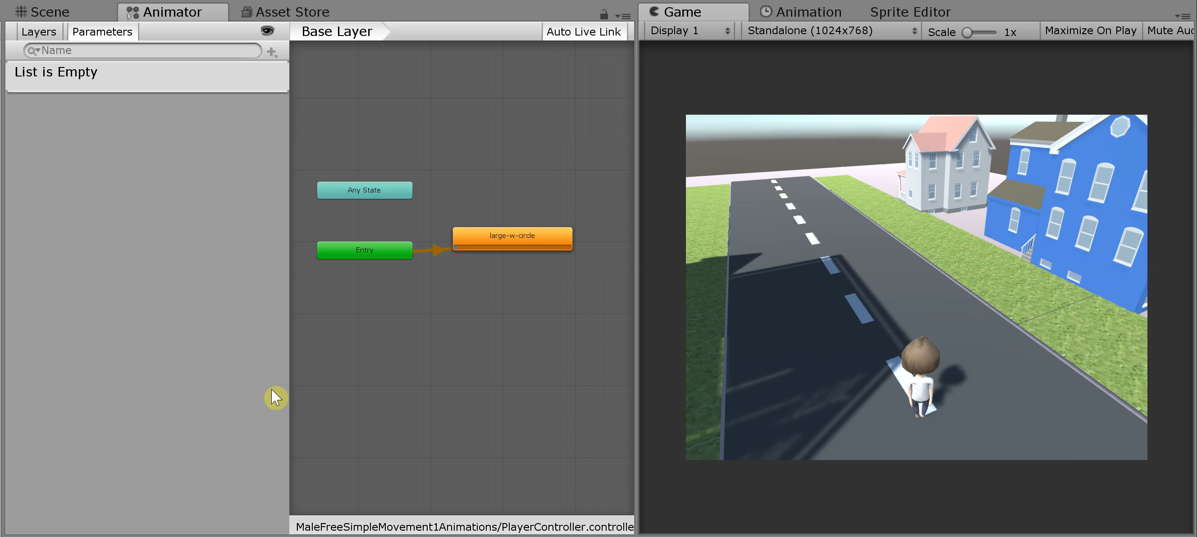
What was accomplished?

Slide 4
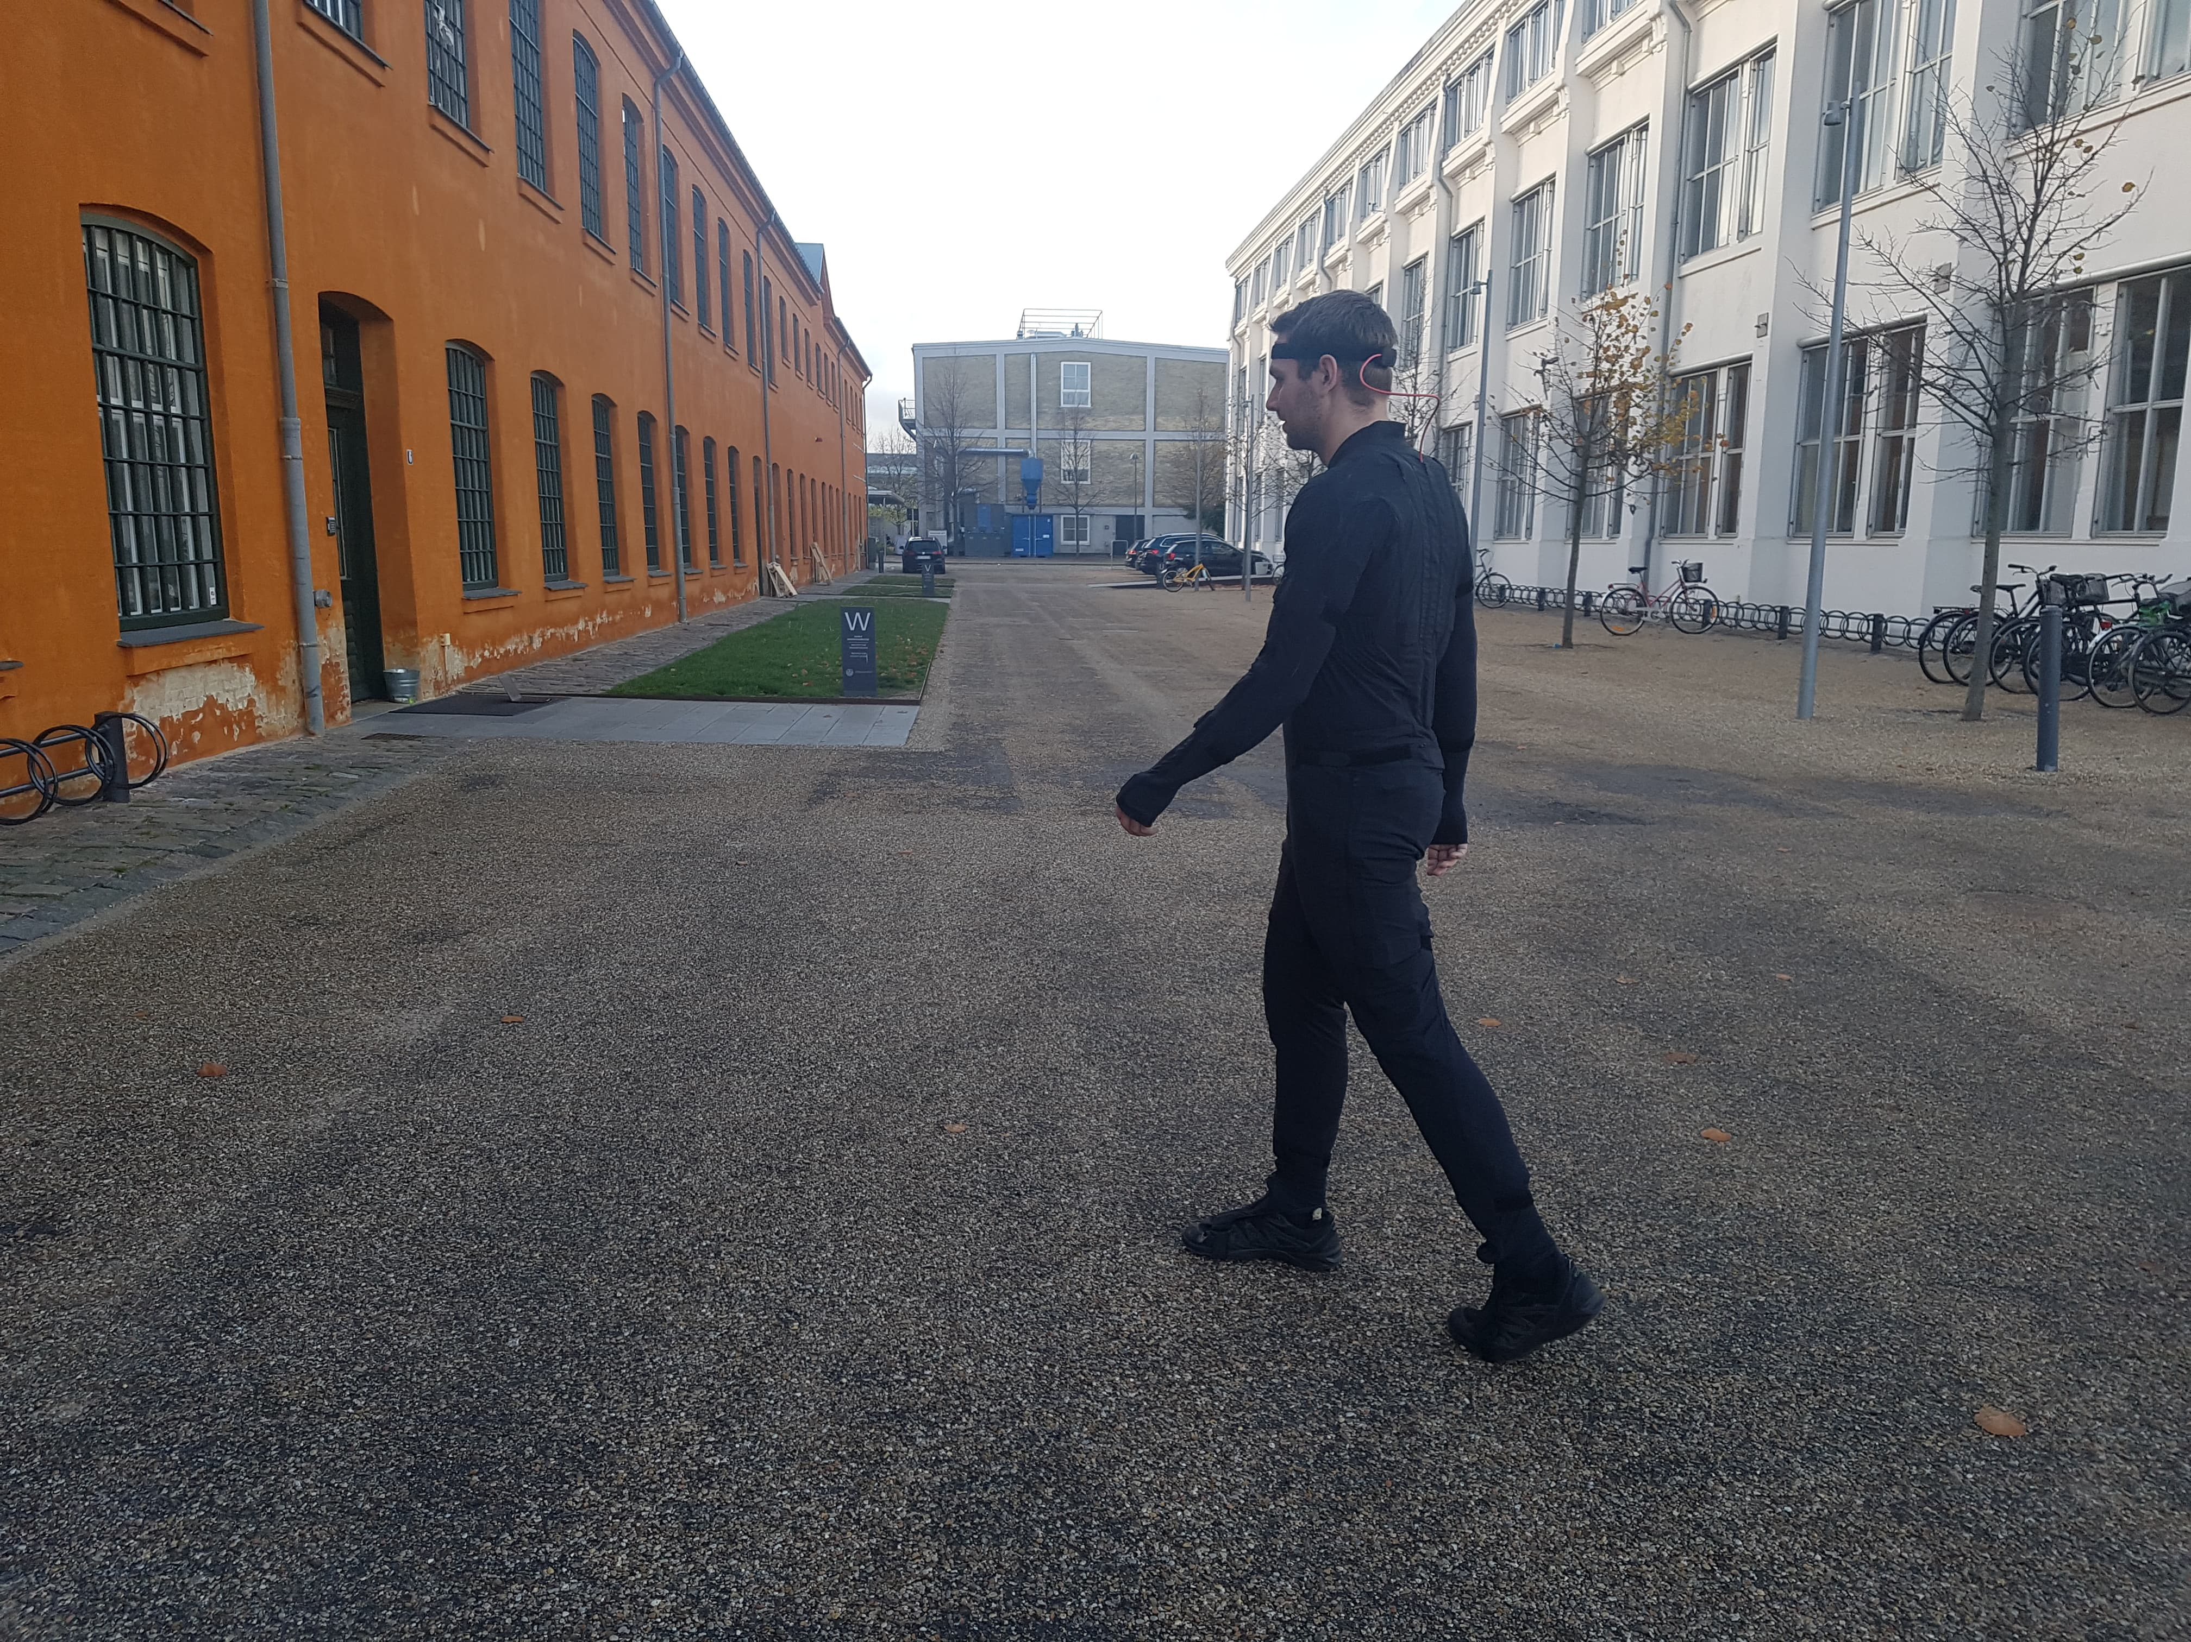
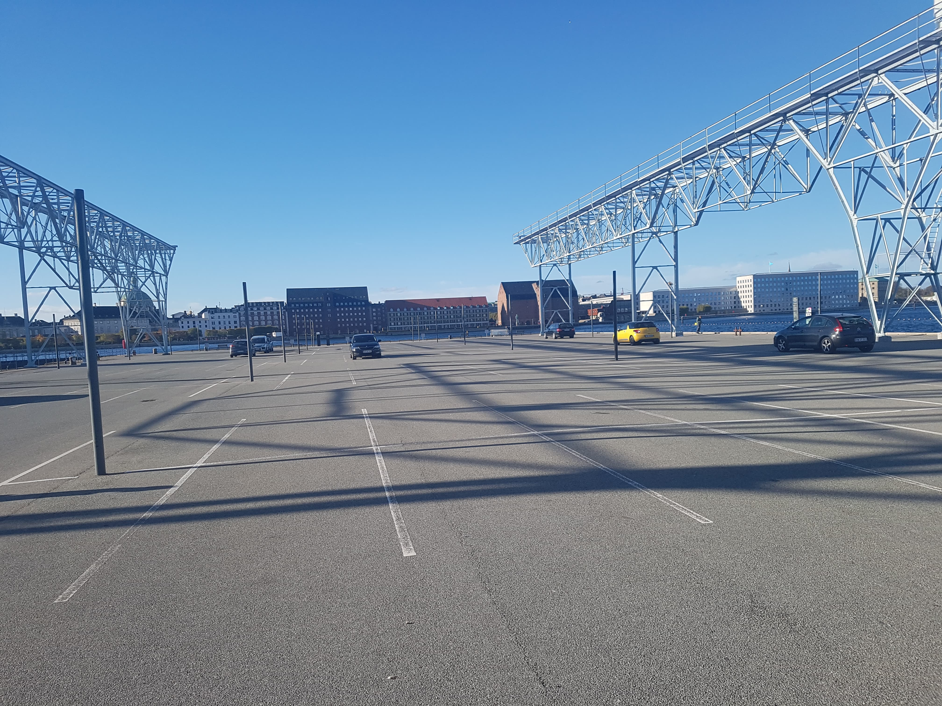
1. Data
Rokoko suit
The set

Slide 5
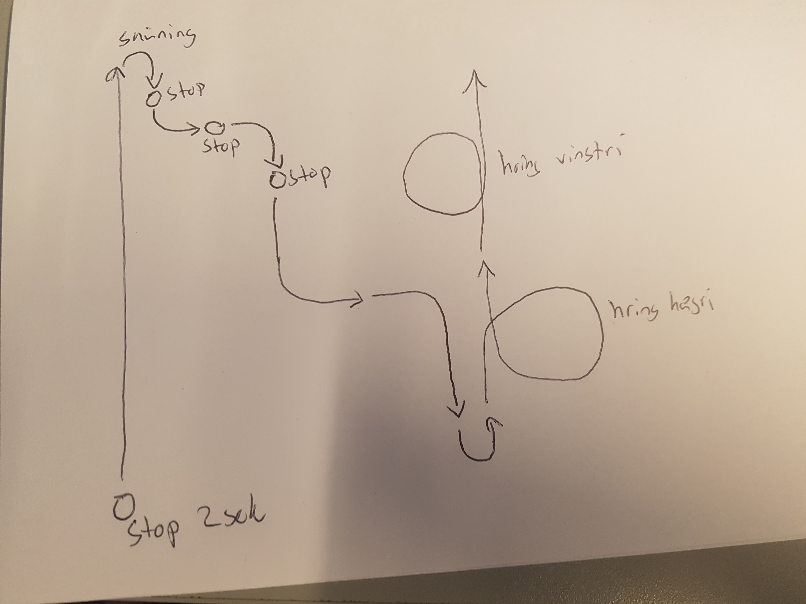
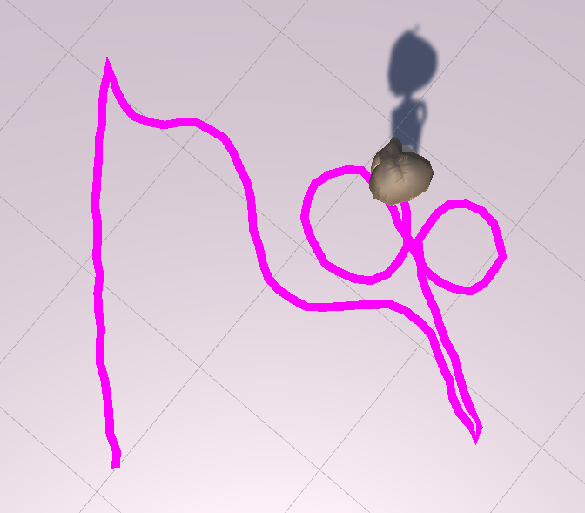
1. Data
The dance card
Playing the clip in Unity

Slide 6
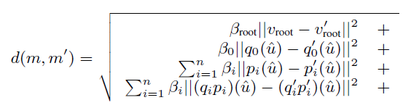
2. Using the data
Exported to .fbx and .bvh
FBX only used to play as a clip in Unity Animator
BVH used for processing
The clip was 1666 frames ~ 55 seconds
For each frame I calculated it‘s 300 nearest neighbors with the similarity function
Only used the root, left upper leg and right upper leg

Slide 7
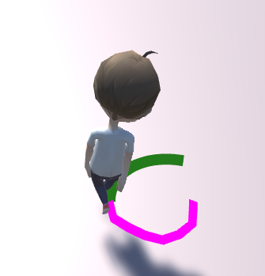
3. Player input
Character is moved by root motion
User gives input by keyboard
With that input we calculate predicted path that he wants to go

Slide 8
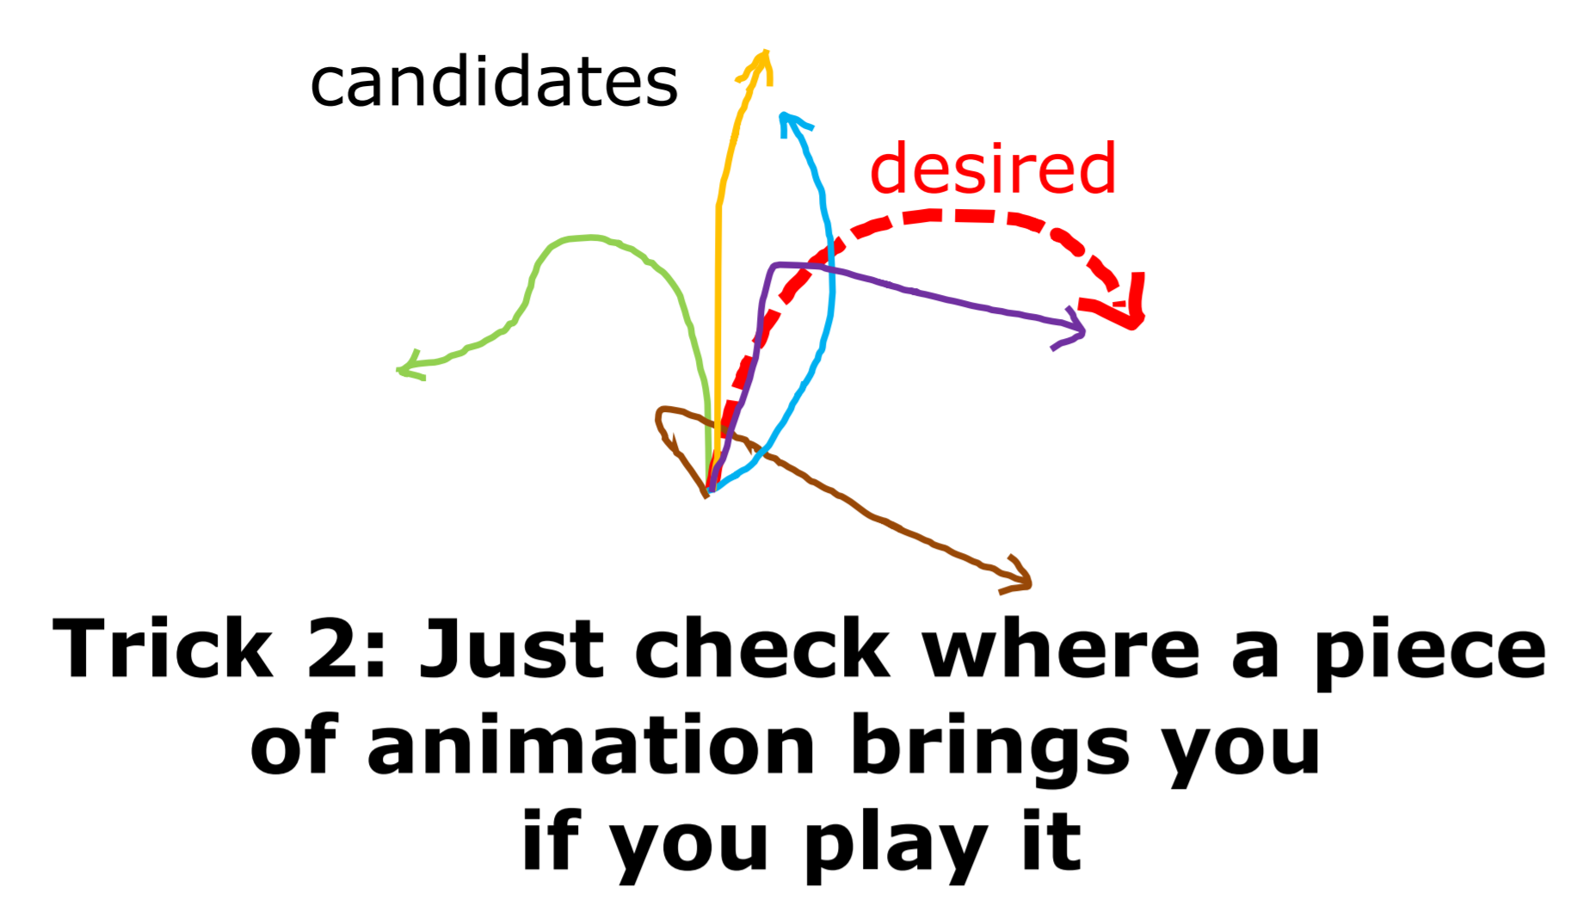
4. Ubisoft‘s Simon Clavet trick

Slide 9
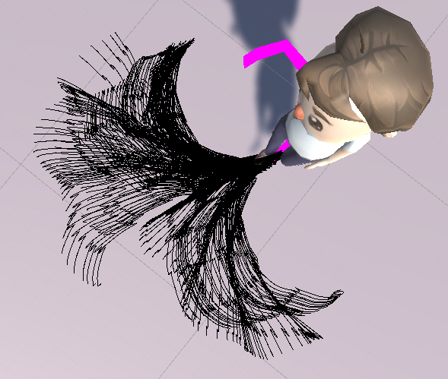
4. Play nearest neighbors trajectory
Impossible to get future position of an animation in Unity‘s Animator?
Solution:
Play clip all the way through with a character and record all of it‘s positions and rotation each frame
Use the displacement between each frame to draw trajectory

Slide 10
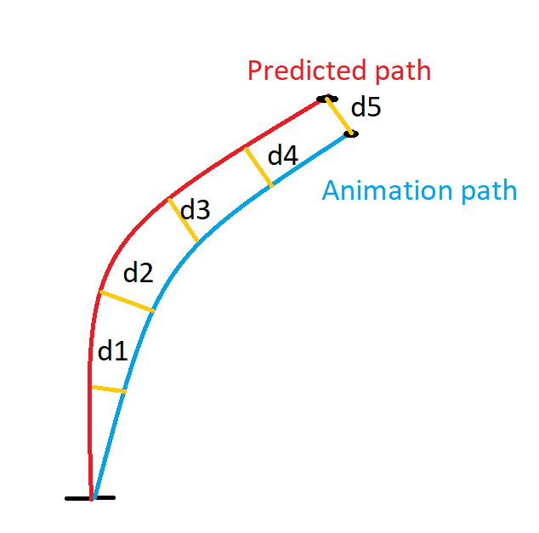
5. Choose the best nearest neighbor trajectory
Six points from predicted path is compared with six points from every nearest neighbor.
The smallest distance is our next animation

Slide 11
Problems
I only make decisions on best nearest neighbor every 30 frames
It‘s really hard to stop the animation
Lag
Sometimes gets stuck in animation loops

Slide 12
How to improve?
Get better data
Do better data processing (maybe neural network)
Use more or change to other bones in the similarity functions
Get more time

Slide 13
What area of the code do I find interesting?
What happens at runtime
I‘m not really interested in machine learning algorithms
I‘ll probably keep working on gameplay in the final game

